Slide 1

26.12.2021
FINAL PROJECT
RFM Model for customer segmentation using K-Means algorithm and predicting CLV
Group 6

Slide 2
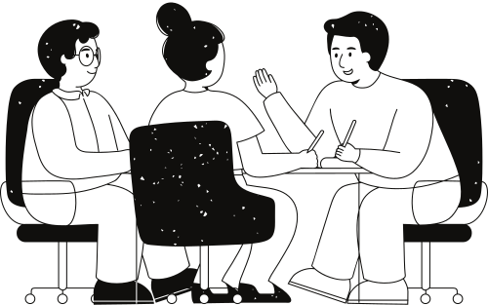
Project Overview
Reason
Objectives
Objects and Scopes
GROUP 6 26.12.2021

Slide 3

Chapter 1: INTRODUCTION
GROUP 6 26.12.2021

Slide 4
Background
1
2
K-Means Clustering
Algorithm
3
RFM Analytics Model
Elbow Method
4
5
6
7
Sum Squared Error (SSE)
Silhouette Index Method
BG/NBD model
Gamma-Gamma model
8
9
10
Customer Retention Rate with Cohort
Power BI
Customer Lifetime Value
GROUP 6 26.12.2021

Slide 5

Research Goals
Calculate customer retention rate monthly by cohort analyst
Construct the customer segmentation model using K-means clustering technique and RFM analysis.
Conduct the customer segmentation based on their customer purchase behaviours.
Predicting CLV using NB/NBD and Gamma-Gamma model
Analyze results and provide recommendations to the business on marketing strategy for each customer segment.
GROUP 6 26.12.2021

Slide 6

Data understanding
The study makes use of a customer transaction dataset taken from the Adventure Works Cycles dataset. This is a worldwide corporation that produces and sells bicycles in North America, Europe, and Asia. From 06/2011 to 07/2014, the retrieved dataset contains 121,317 transactions from the company. This applies to both individuals and businesses. To be more specific, the percentage of customers in each country is different and the US is the biggest market. According to that, the transactions in the US (United States) market were excluded from the analysis in terms of analyzing the optimal customer segment for each different market.

Slide 7


Data preprocessing
First, we select appropriate features from the main data to build the model, bring it into a dataset. The main task in this step is to clean the data set and remove missing values and null attributions. Then transform it from raw data to the useful format that has normal distribution. We will use this data to build the model.
GROUP 6 26.12.2021

Slide 8
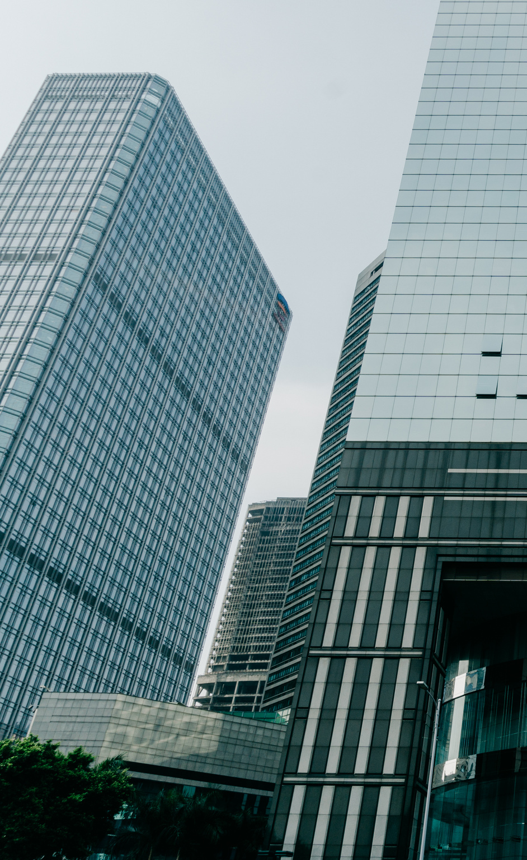
Chapter 2: RFM MODEL WITH
K-MEANS CLUSTERING

Slide 9
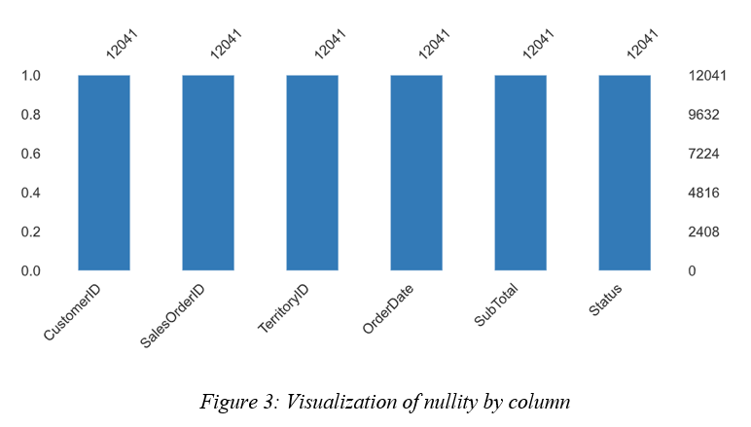
EDA
Descriptive Analysis

Slide 10
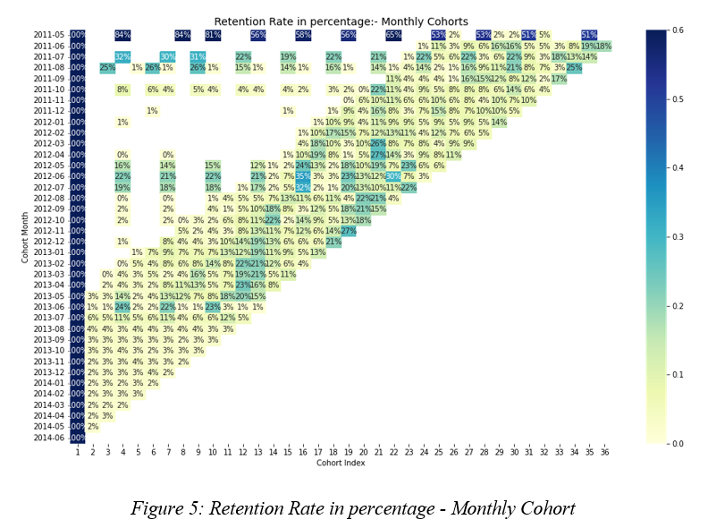

Cohort Analyst based on time

Slide 11
Cohort Analyst based on time
Customers did not transact regularly after the first 3 months, but after the 4th month, most customers started reorder again.
Generally, the company's customer retention policy was appropriate for the period before 2012 and was able to retain this group of loyal customers until the end of the period.
The first order made in May 2011 and the last order was recorded in June 2014 and there are 36 cohort indexes. The darker the blue

Slide 12
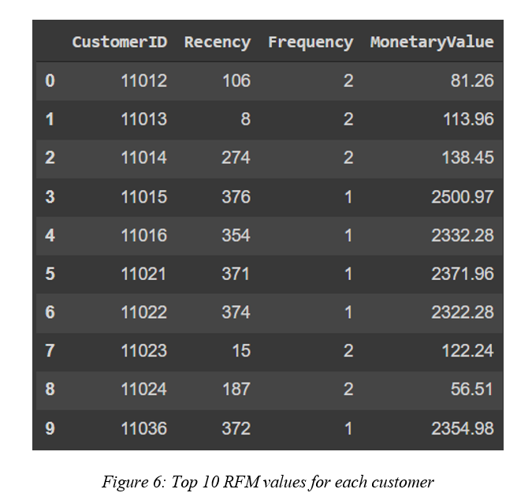

Customer segmentation based on RFM model
Calculate the RFM values.

Slide 13
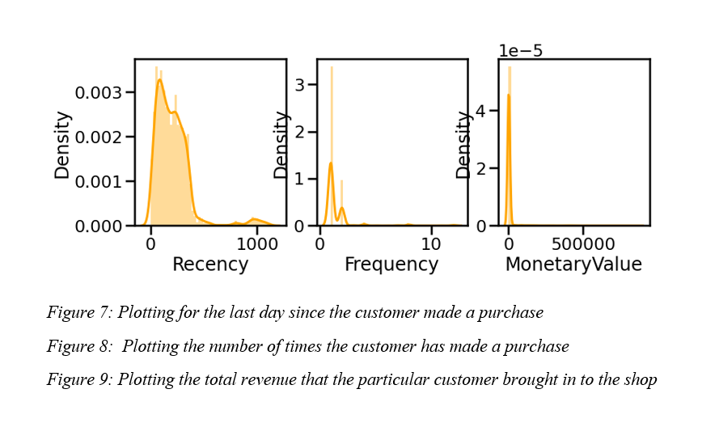
Customer segmentation based on RFM model
Descriptive Analysis

Slide 14
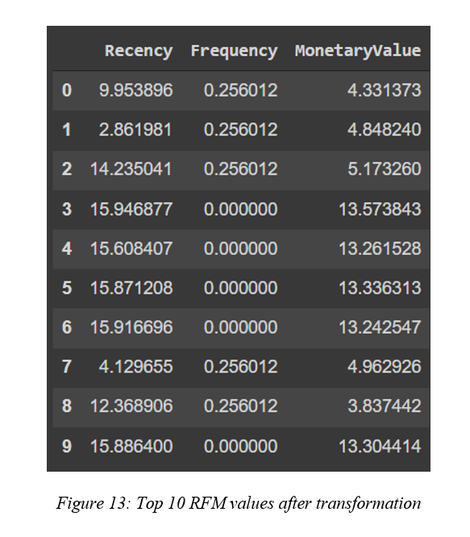
Customer segmentation based on RFM model
2. Transform the dataset.
We choose a method that has the result more approximately 0, which is the Box Cox method to transform the data for achieving normality. After that, we had the new dataset as in figure 13

Slide 15
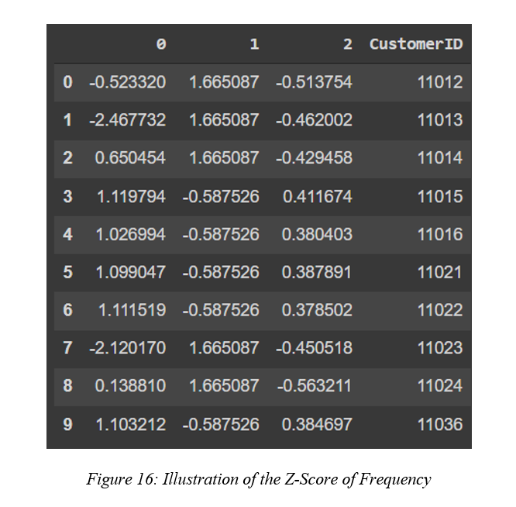
Customer segmentation based on RFM model
3. Standardize features
Because of the distribution of the values ​​of the elements in the data set and the effects of outliers on the clustering results, the solution is to convert the above values ​​to the same units as the standard score distribution also known as Z-score.

Slide 16
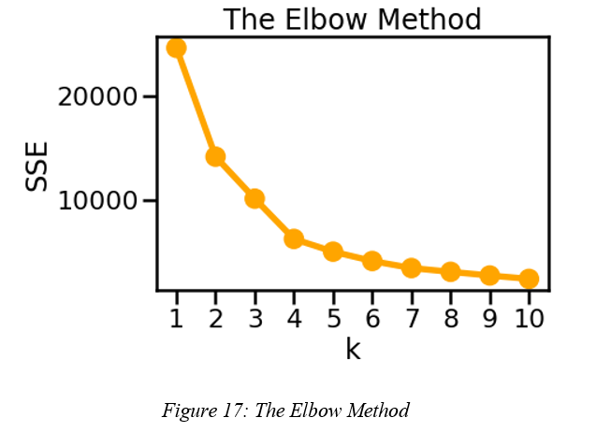

Customer segmentation based on RFM model
4. Choose the optimal clusters number for K-means
The Elbow method is illustrated as a curve graph with the horizontal axis being the number of K clusters, the vertical axis being the SSE.
Carrying out the Elbow method with the number of clusters from 1 to 10 on the RFM model, the results are as follows
With the above SSE curve, the team found that the elbow bend with K = 5 and K = 4 would be an appropriate number of clusters.

Slide 17
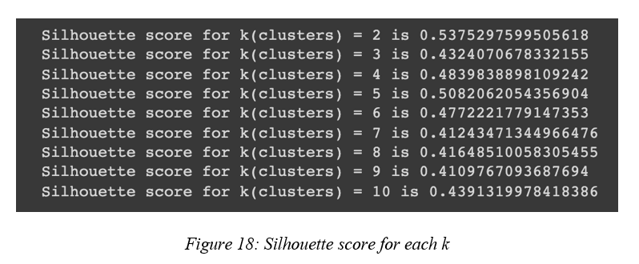
Customer segmentation based on RFM model
5. Cluster quality verification with Silhouette index
Silhouette score for cluster 5 is 0.5082 and is the highest in the range for k from 3 to 10.
Which means that with k = 5, the distance from the point of the cluster to the core of the cluster was optimal and it is close to reality. As a result, we choose K = 5 to cluster

Slide 18
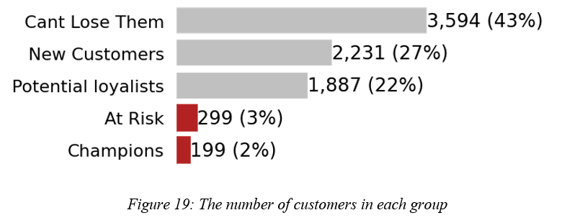
Customer segmentation based on RFM model
6. Cluster customer segments and visualize analytics results
We give each cluster a segment based on their characteristic
Analyze and visualize clustering results with scatter plots on three-dimensional space.

Slide 19
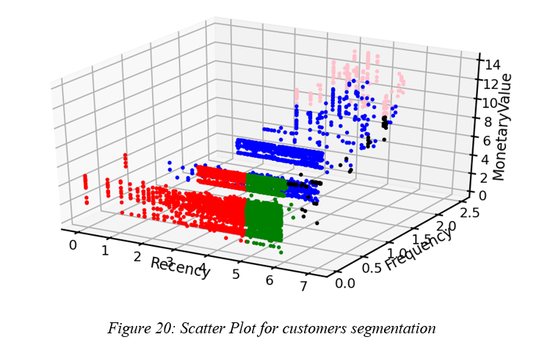
Customer segmentation based on RFM model
6. Cluster customer segments and visualize analytics results
Cluster 0 points is green with 3594 points - can’t lose them
Cluster 1 points is blue with 1887 points - Potential loyalists
Cluster 2 points is red with 2231 points - new customers
Cluster 3 points is black with 299 points - At risk customers
Cluster 4 points is pink with 199 points - Champions

Slide 20
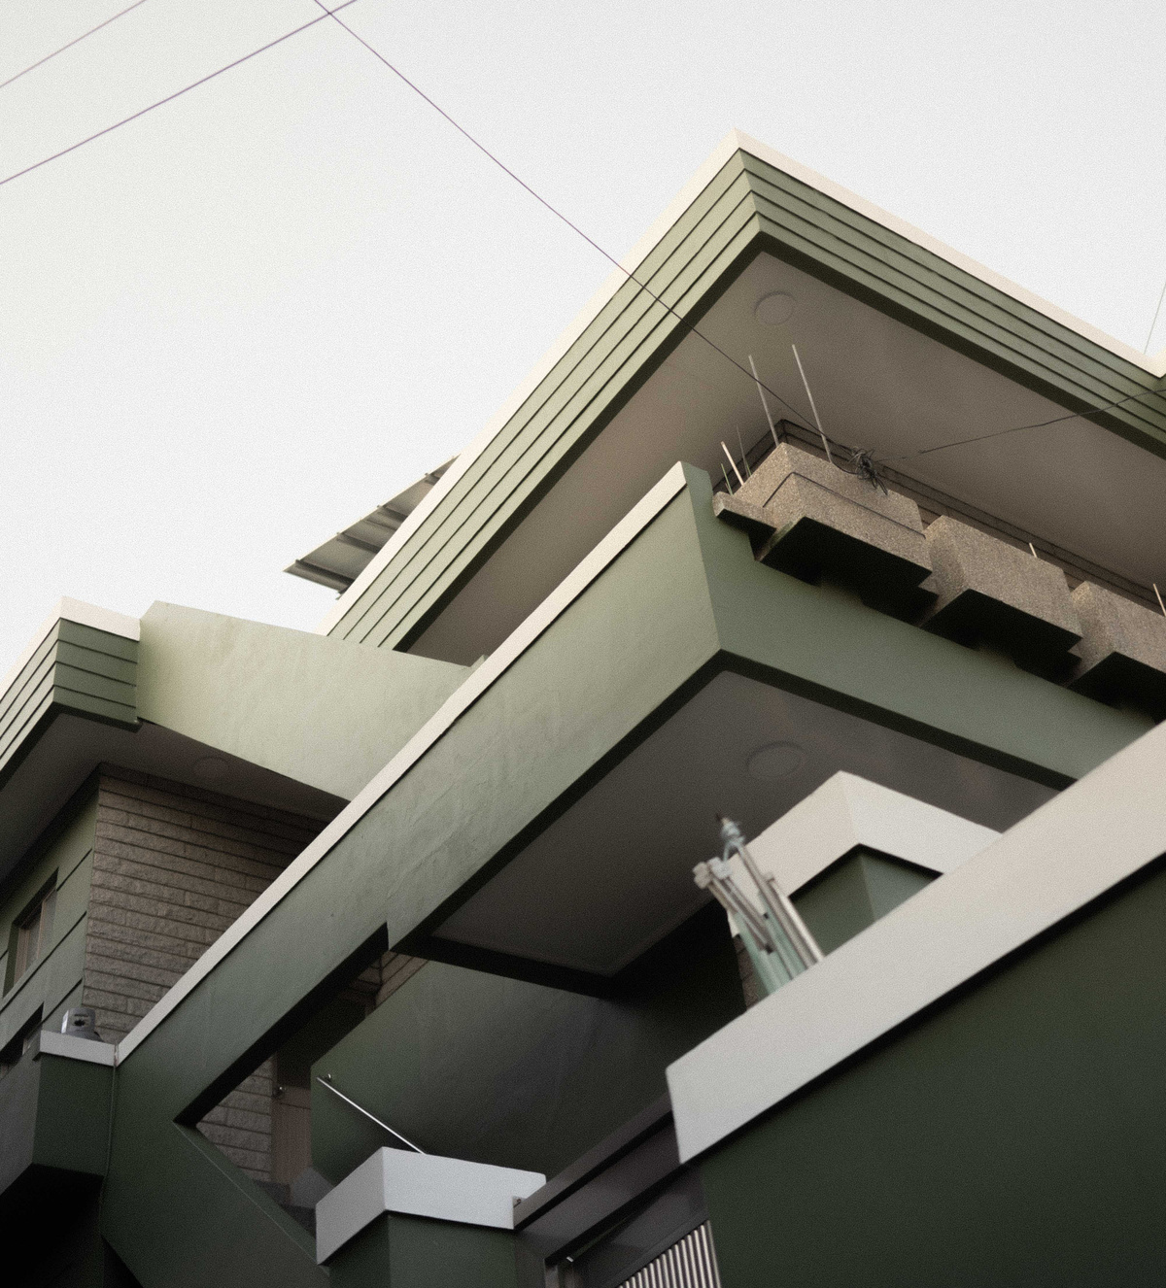

Analysis of the groups of customers based on the quartile description

Slide 21
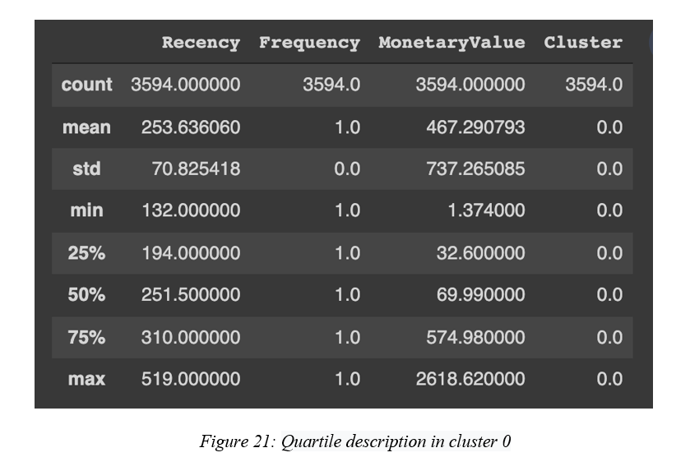
Analysis of the groups of customers based on the quartile description
Analyzing the group Can’t Lose Them (cluster 0)
This customer segment is the largest customer group.
The frequency of purchases is very low and tends to stay low
The average Rencency is very high
Spending is the lowest of all segments
The value contribution of this group of customers is not high and not outstanding
=> The value contribution of this group of customers is not high and not outstanding
=> The company should not ignore this Cluster. Bring them back with relevant promotions, and run surveys to find out what went wrong and avoid losing them to a competitor. This can be applied together with up-selling and cross-selling strategies.

Slide 22
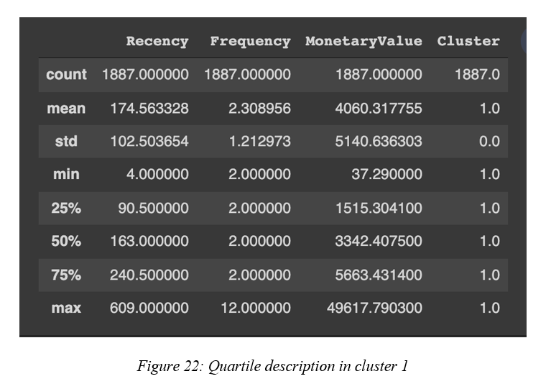
Analysis of the groups of customers based on the quartile description
2. Analyzing the group Potential Loyalists (cluster 1)
This group of customers usually has the nearest purchase date
The average purchase frequency is 2.3 times higher than the other groups
The customer group may be willing to spend a lot of money on shopping.
we can see that this is not only a loyal customer group and even a customer group that brings great potential to businesses.
The company should offer membership or loyalty programs or recommend related products to upsell them and help them become your Loyalists or Champions.

Slide 23
Analysis of the groups of customers based on the quartile description
3. Analyzing the group New customers (cluster 2)
The spending level is not too high
The total number of customers in the group is still quite large
The frequency of purchase is still once
The recency index of this group is at the highest level
=> With this group of customers, businesses can continue to improve their current sales policies to retain the group. Besides finding out potential customers in this group and promoting them to become loyal customers. Start building relationships with these customers by providing onboarding support and special offers to increase their visits.

Slide 24
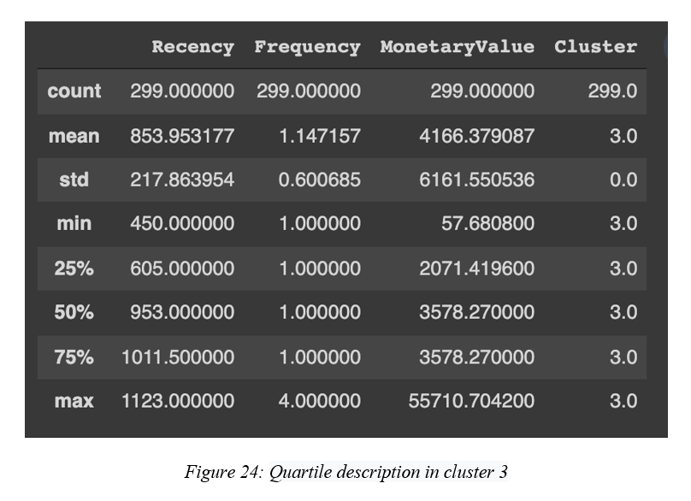
Analysis of the groups of customers based on the quartile description
4. Analyzing the group At risk customers (cluster 3)
The recency index is quite high
There are still customers who spend very high up to 55710.7 units
Send them personalized reactivation campaigns to reconnect, and offer renewals and helpful products to encourage another purchase.

Slide 25
Analysis of the groups of customers based on the quartile description
5. Analyzing the group Champions (cluster 4)
With consumption up to 80.99% of total revenue, the number of customers in this group only accounts for 1.65% of the total number of visitors.
The frequency as well as the average business spending is also very high
According to the Pareto principle that 20% of customers will bring 80% of sales, this group of customers is called VIP, Priority or high-class customers
This company should reward these customers to retain them. Moreover, they can become early adopters for new products and will help promote your brand. However, the number of customers in this cluster only accounts for a small part of the total number of customers, the company may need to have policies to change products to catch up with market tastes or strengthen marketing to attract customers

Slide 26

Chapter 3: RFM model for customer segmentation by Power BI

Slide 27
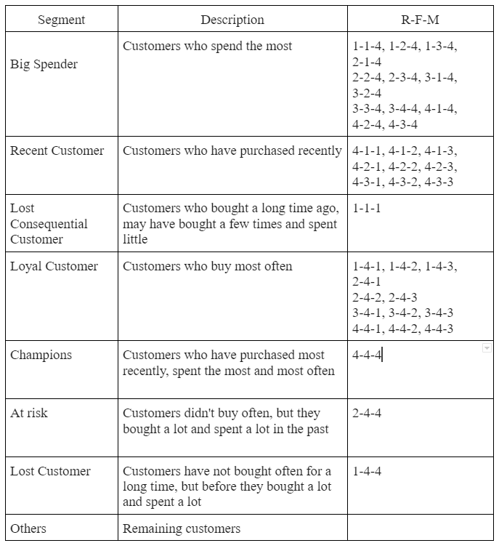


This model is based on Business Rules to classify customer sets.
After each customer has an RFM classification score from 1 to 4, the higher the score, the more valuable the customer is according to each indicator. From here we can combine this set of points to create customer sets.

Slide 28
Chapter 4: Predicting CLV
Calculating Customer Lifetime Value or CLV is considered a really important thing in marketing and ecommerce, yet most companies can’t do it properly. This clever metric tells you the predicted value each customer will bring to your business over their lifetime, and as such requires the ability to detect which customers will churn as well as what they’re likely to spend if they’re retained.

Slide 29
I.Calculating CLV
1. Which customers are still customers
2. Who will order again in the next period
Here we’re going to use models BG/NBD model and the Gamma-Gamma model - to predict the following:
3. The number of orders each customer will place
Calculate the raw recency, frequency, and monetary metrics
4. The average order value of each customer’s order
5. The total amount each customer will generate for the business

Slide 30

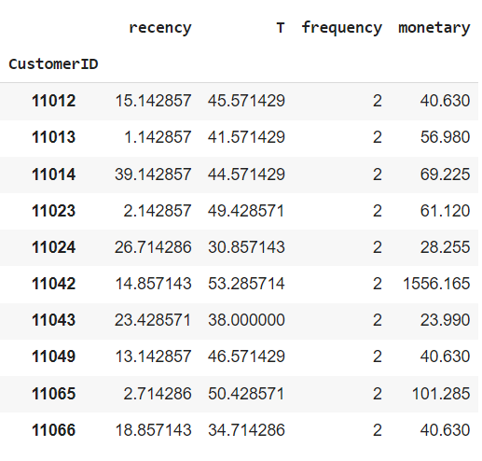
The next step is to turn our raw transactional data into the recency, frequency, monetary and tenure (T) metrics we need to provide to the CLV models. While it’s relatively straightforward to do this manually using Pandas. After using, we have a table like that:
Top 10 values of the dataset1.

Slide 31
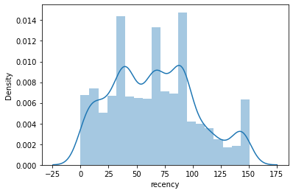
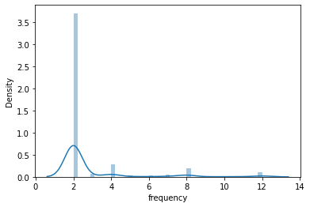
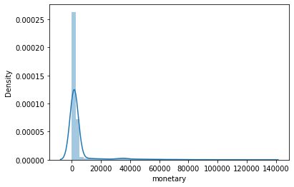
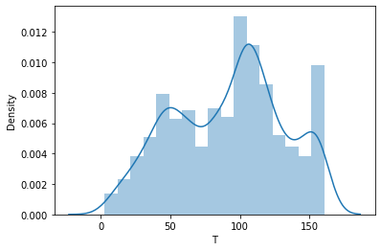
Plot for recency in dataset1
Plot for frequency in the dataset1.
Plot for monetary in the dataset1
Plot for T values in the dataset1.

Slide 32
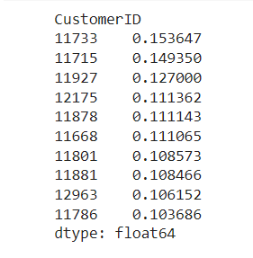
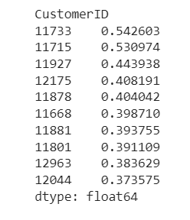
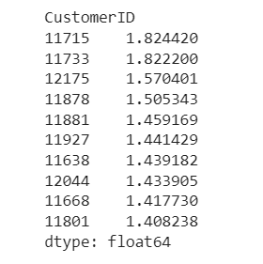
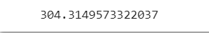
II.Fit the BG/NBD model
We can fit the model using the frequency, recency, and T data and then view a summary. The model will help us predict which customers will return in the near future
Customers who will return within the next 1 week
Customers who will return within the next
10 customers expect to buy the most in the next 6 months
Total transactions made in the next 6 months:

Slide 33
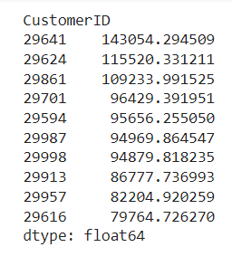
III.Fit the Gamma-Gamma model
If you run the conditional_expected_average_profit() function on the fitted ggf model you get back the predicted average order value for each customer. If you have customer-level profit data, you can also fit the model using this data instead of their revenue, providing it’s the mean and is consistently calculated.
Top 10 customers that bring most values

Slide 34
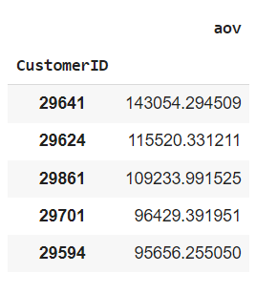
Now we’ll take the Series returned by the above function and assign it to a dataframe, placing the predicted AOV value in its own column and leaving the customer_id value in the index. If you sort the aov column in descending order and reassign the sorted data back to the dataframe, you can then look at the top and bottom of your customer list.
The top aov values

Slide 35

Here’s a plot of their AOVs
Plot for aov scores

Slide 36

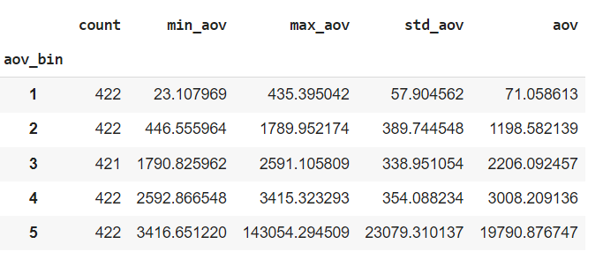
IV.Segment customers by their AOV
To get an idea of the spread of AOV across customers we can use quantile-based discretization or binning via qcut(). We can take the data frame above and create five bins labeled 1 to 5, reset the index, and then create an aggregation to calculate the summary statistics based on the aov_bin.

Slide 37
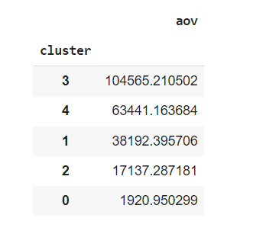
I'M DREAMING OF A
Applying K-means clustering
5 clusters by aov points

Slide 38
V.Predicting Customer Lifetime Value
Finally, we’ll get to the good bit - predicting Customer Lifetime Value. To do this we’ll use both models - the BG/NBD model to predict the number of orders and the Gamma-Gamma model to predict their values. First we’ll re-fit the BetaGeoFitter BG/NBD model to our dataset for the returning customers, which includes the monetary data.
Next, we’ll use the Gamma-Gamma model’s customer_lifetime_value() function to predict their value. We’ll pass in the bgf model, along with the recency, frequency, monetary_value, and T data for each customer. The time parameter is in months and defines how many months into the future we wish to predict.

Slide 39
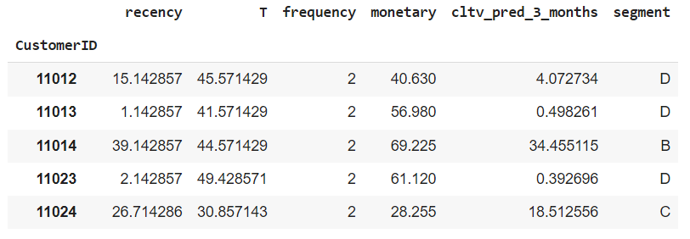
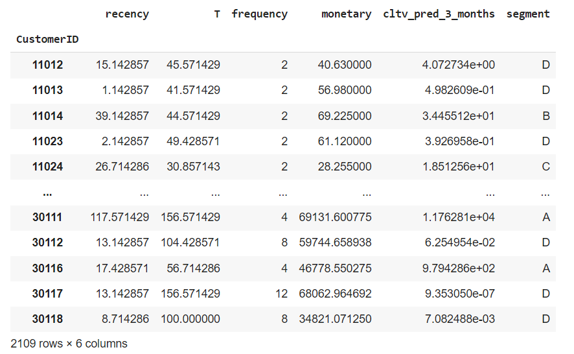
The customers' lifetime values expected to in the next 3 months
Customer segmentation by CLV

Slide 40
thank for listening
Have a good day!

